Slide 1
KINES 7103 Research Design and Analysis.
Keith Lohse, PhD, PStat
Department of Health and Kinesiology
Department of Physical Therapy and Athletic Training
University of Utah
e: rehabinformatics@gmail.com

Slide 2
Small Group Exercise
First, let’s go around and introduce ourselves:
Give your name and the department you are working in.
Second, I will randomly assign you to breakout rooms for 5 minutes.
Your goal is to find out who was born earlier in the year and later in the year, getting the correct order of your group perfectly correct.
Note, not the year of your birth, but the time of year you were born.
However, you cannot directly refer to:
Months or days either numerically or categorically.
Holidays or the academic calendar.
Once you think you have the answer, check your order and report back if your were 100% correct.

Slide 3
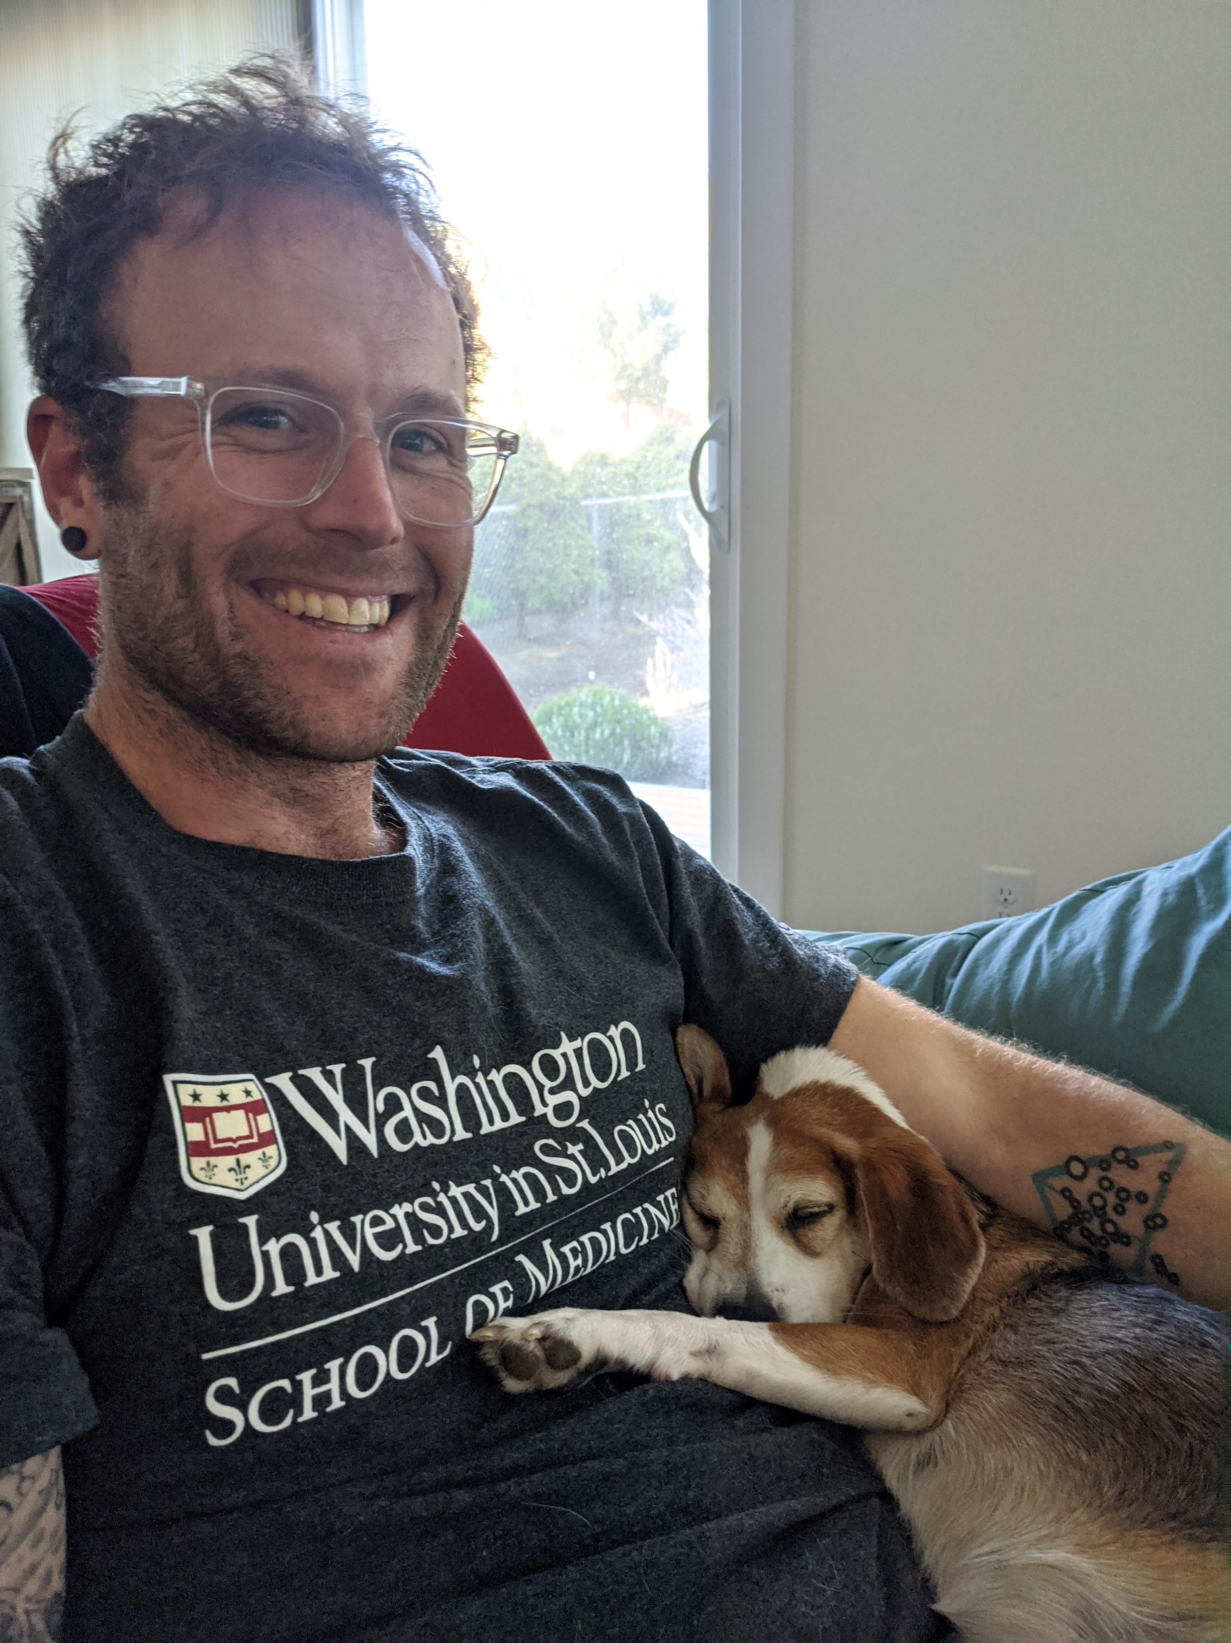
About Me…
In my research, I want to improve our understanding of the mechanisms underlying neurological rehabilitation.
My background is in quantitative psychology.
I am accredited as a professional statistician (“Pstat”), by the American Statistical Association.
I am part of the ASA’s teaching statistics in the health sciences section.
I have taught statistics in some capacity at either the undergraduate or graduate level since 2007.

Slide 4
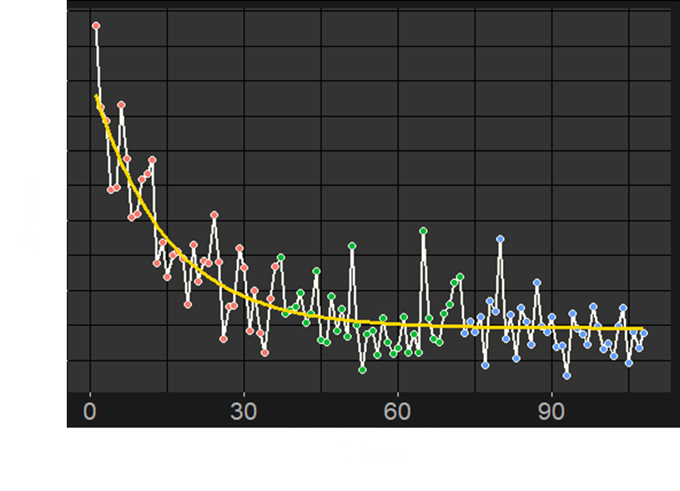
About Me…
As a methodologist, my work has spanned:
Preclinical research to meta-analyses of RCTs.
Experimental work to observational studies using the electronic health record.
Small case-series (N=4 spinal cord injury patients) to large scale international consortia (ENIGMA and ISGC).
My expertise is in longitudinal data analysis and unpacking individual difference is recovery.
Accounting for individuals nested within sites, time nested withing individuals, etc.

Slide 5

In this class…
“Big Data!”
“ –Omics!”
“Machine Learning!”

Slide 6

In this class…
“Big Data!”
“ –Omics!”
“Machine Learning!”

Slide 7
In this class…
The better you are with the key concepts of regression and the general linear model, the better prepared you will be to tackle to “big data” projects and topics.
Understanding your statistical fundamentals is important to avoiding mistakes!

Slide 8
In this class…
There is no required text for this course. Instead, I will ask you to watch videos that I have recorded for the different modules.
Week-to-week, you will be asked to:
Watch the videos in your own time (asynchronous).
Complete a short online quiz for that module.
Attend the Tuesday lab sections 4:30-6pm (synchronous).
Attendance is not mandatory, but it really helps!
Complete the lab assignment and turn it in before the start of the next lab.

Slide 9
In the labs…
Our labs will generally follow a similar format. Part of the assignment will involve me walking through an analysis with you using an example dataset.
The second part of the assignment will require you to use your own data (or one of the datasets from the class), to apply those skills in your own analysis.
You can help each other both in the lab and outside of lab.
Data Lab has “how to” videos for different statistical tests in Jamovi: https://datalab.cc/jamovi/
But they also have resources for R:
https://www.youtube.com/playlist?list=PLkk92zzyru5OOYKXfC4OWzc4Lzo_lBOLP
and SPSS:
https://www.youtube.com/playlist?list=PLkk92zzyru5MvAyPw5QXzpCMlHg6LTwzH

Slide 10
In the labs…
Questions
Open questions from the modules.
Broad conceptual questions.
Guided lab
I will walk you through statistical analyses we are working on that week in Jamovi.
Small groups
Use your own data or one of the example datasets from the class.
Questions
Working together, you can work on the remaining lab questions.
Ask any follow-up questions so that you can complete the assignment or resolve any uncertainty.
Outside of lab
Come to office hours if you have questions!
Continue working individually or with your peers to complete the lab assignment.

Slide 11
Final Lab Notebook
The final assignment in this course is the development of a lab notebook that serves as a guide/tutorial for how to analyze different types of research designs.
Work together in as big (or small) of a group as you want.
You need to clearly identify everyone who was in your group.
Students from the same program often work together as their research is more similar.
Integrate your lab assignments, refine them, use screen shots from Jamovi!
You need one chapter for each of the different statistical tests we cover in the class.
But you can include additional examples or designs as desired.

Slide 12

Developing Analytic Skills and Knowledge
R is a statistical programming language that is free and tremendously powerful. However, it is also code-based, so the learning curve is steeper.
I think the effort is well worth it, as it will give you tremendous freedom and skill in your future work.

Slide 13

Developing Analytic Skills and Knowledge
In this course, we will focus on Jamovi, which is a free program that provides a graphical user interface that implements R code. If you are really interested in R, you can export the code from the menu driven actions in Jamovi to implement the same actions in R.

Slide 14

Developing Analytic Skills and Knowledge
SPSS is a paid statistical program from IBM that uses a proprietary 4GL language. It is also very good, but its cost can be prohibitive for many students. If you have access to SPSS, you are welcome to use it in the course. Jamovi has a very similar interface to SPSS, so if you practice with Jamovi here, your skills should transfer to SPSS later.

Slide 15

Developing Analytic Skills and Knowledge
I have significant expertise with all three of these programs. You are welcome to use any of them in this course and I am happy to work with you on your own data in office hours or in the various lab assignments that we have.
You are also welcome to use other statistical programs (STATA, Statistica, etc.), but I have much less experience with these programs and will be less able to help you.

Slide 16
Grades in the Course
This course is based around gaining experience points (XP), which is based on the number and quality of assignments that you submit.
Online Quizzes (30% of XP)
Lab Assignments (50% of XP)
Final Lab Notebook (20% of XP)
See the course schedule on Canvas for the modules/designs that we will be covering.

Slide 17
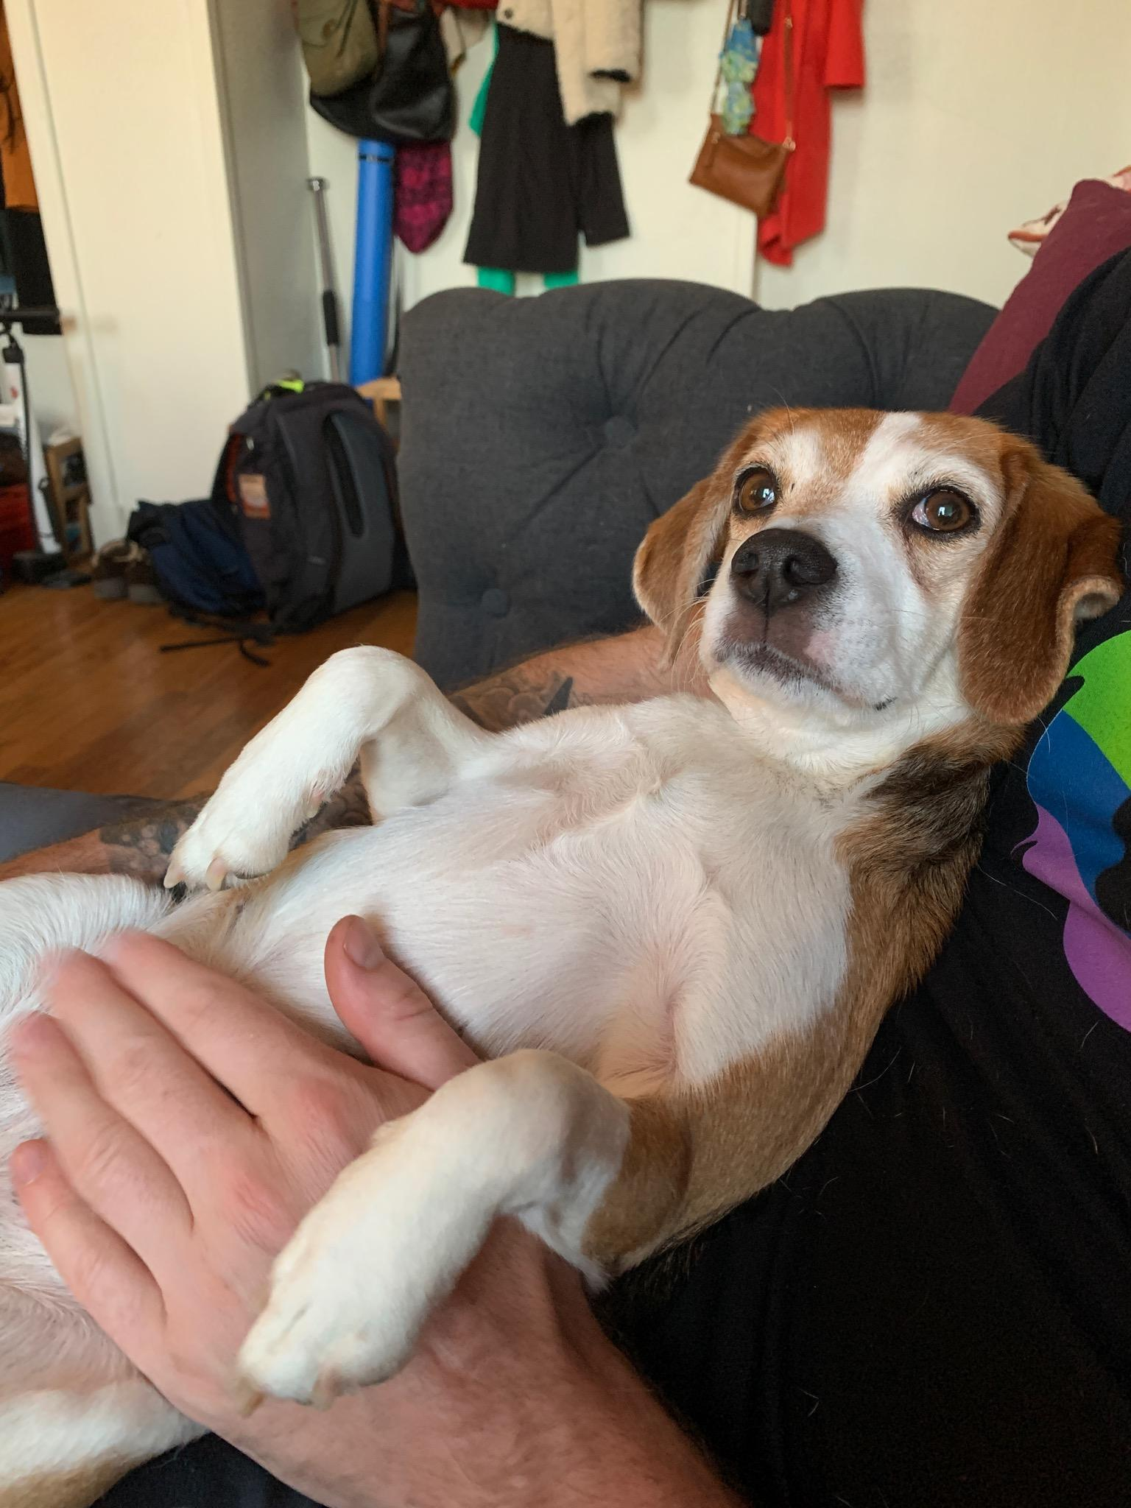
Conclusions
That’s a lot to process…
So that is a lot, but please take a look at the syllabus on Canvas.
Please also complete the pre-class survey if you haven’t already.
We’ll now break into our first lab assignment (mostly about installing Jamovi) and work in small groups.
We’ll come back together at the end to see if questions crop-up.
[Olive, a very smart beagle]

Slide 19
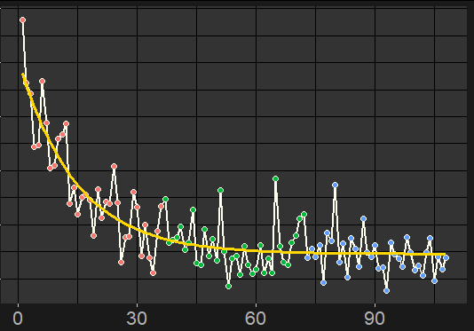
Modeling Learning and Recovery
Rehabilitation science fundamentally requires tracking some variable of interest over time.
We can explain these data with an exponential decay function.
Errors
Time
[Olivier, Paul, Lohse, et al., JNPT 2019]
Notes:
In my research, I model the psychological processes of human learning, the physiological mechanisms of recovery, and how they interact during rehabilitation.
My PhD is in cognitive psychology where I learned to model human learning. Given my quantitative expertise, I am also accredited as a professional statistician by the ASA.
I approach rehabilitation with the background of a quantitative psychologist.

Slide 20
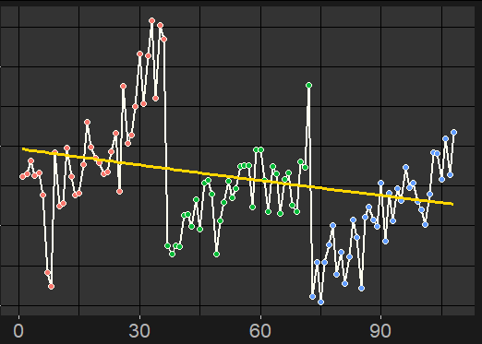
Modeling Learning and Recovery
But this person’s data do not follow an exponential decay function!!!
This person gets worse during any given day, but also improves from day to day.
[see also Park & Schweighofer, 2017]
Errors
Time
[Olivier, Paul, Lohse, et al., JNPT, 2019]

Slide 21
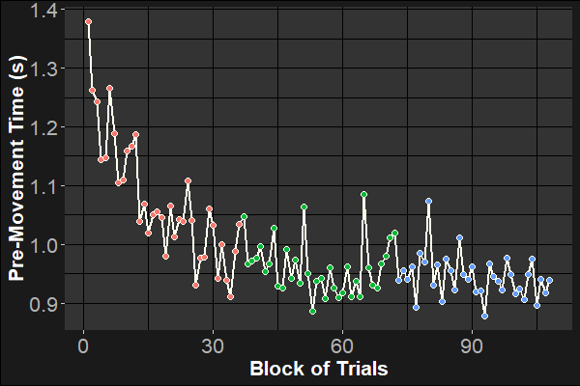
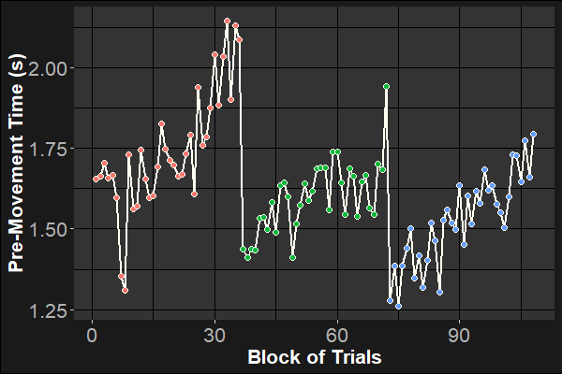
Flexible Statistical Models
Errors
Errors
Time
Time
Using these models, we can answer important basic and applied questions in rehabilitation science. [Lohse et al., APMR, 2016; Lohse et al., Bio Psyc, 2019; Oliver, Lohse et al., JNPT, 2019]

